Slide 1

To be removed
Notes:
Co-occurence: buying different brands on the same trip can cause negative cross price elasticity

Slide 2

Instant Coffee User Analysis
Notes:
Co-occurence: buying different brands on the same trip can cause negative cross price elasticity

Slide 3
The Data
Raw panel data | Transformations
One year 270,000 Individual level transactions XX Brands, XX Shops Price and promotions Household IDs …. | Spending by household Susceptibility to promotions Brand loyalty (coffee and shops) Price elasticities Market shares ….

Slide 4
Our findings
To be removed
Brands, Stores
Price / Purchase Analysis
Elasticities
Market Share
etc

Slide 5
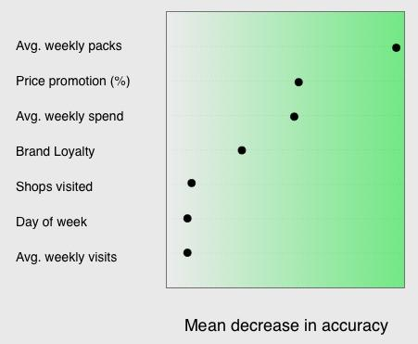
Variable Importance for Light vs Heavy Users

Slide 6
Variable Importance for Light vs Heavy Users
Heavy users = 75th %
Light users = 25th %

Slide 7
Introducing….
To be removed
Side by side analysis: Light vs Heavy users

Slide 8


Introducing….
Ben and Elvira

Slide 9
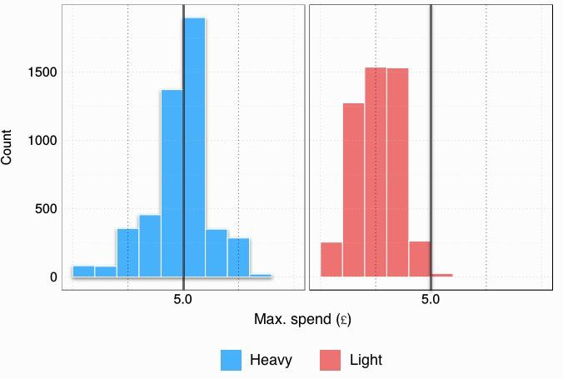
Spending Behaviour

Slide 10
Promotional Features

Slide 11
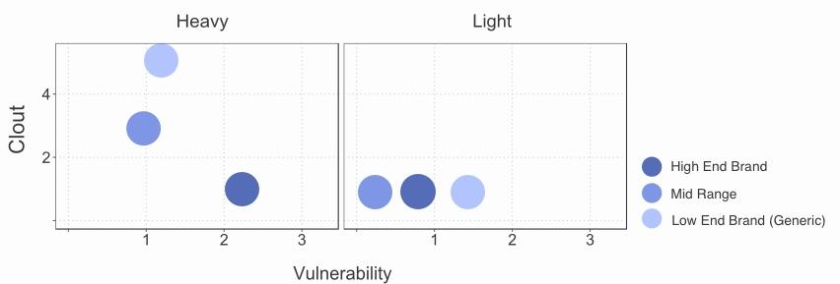
Importance of Brand

Slide 12
Importance of Brand

Slide 13
Importance of Brand

Slide 14
Conclusion / Summary / Reccomendation
Brainstorm together...

Slide 15
BONUS MATERIAL
More in depth info: what was done to the data
Summary Tables / Analysis of models
Comparison of models -> choice
Statistical significance of variables
User behaviour variables
Loyalty

